Slide 1
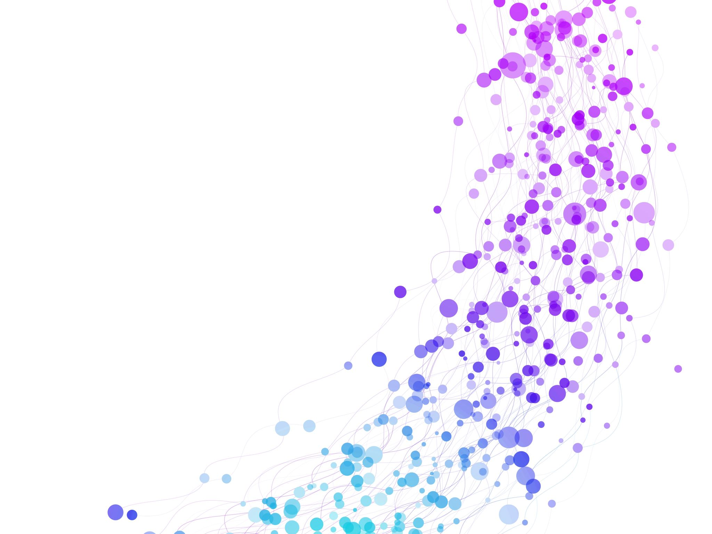

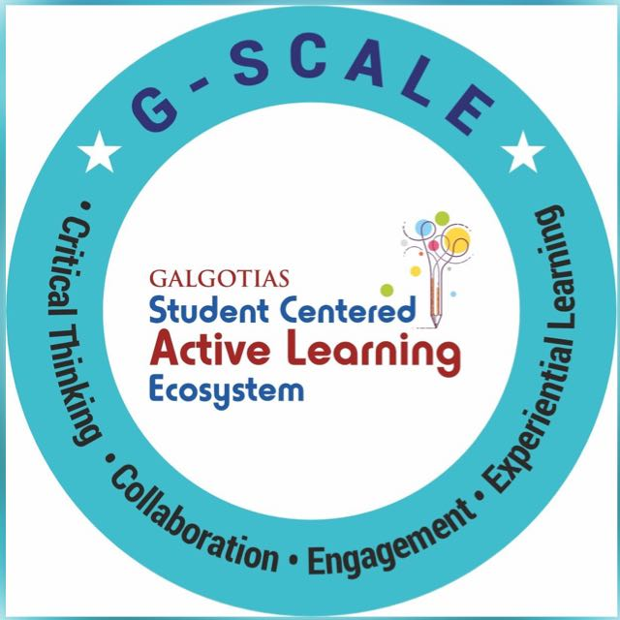
NLP techniques and NLP applications Lecture No.: 2 Course Name: Natural Language Processing Course Code: R1UC616C Instructor Name: Mr. Amit Yadav

Slide 2
Reflect on the responses of post session activity
Reflect on the responses of post session activity
Galgotias University
2

Slide 3
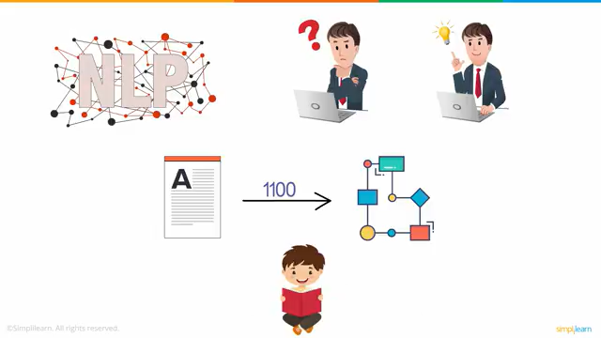

Slide 4
At the end of this session you will be able to
Apply NLP techniques like segmentation, tokenization, stop word removal, stemming, lemmatization, POS tagging, and NER tagging.
Identify real-world NLP applications and understand their functionalities.

Slide 5
Session Outline
1 Introduction of NLP techniques (Opening Video)
2 Activity 1: Jigsaw
4 Activity 2: MCQ
5 Summary
3 Application of NLP

Slide 6
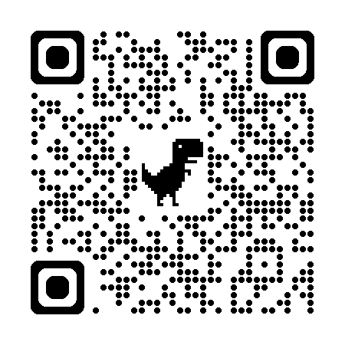
Resource Document: https://drive.google.com/file/d/1-t_ejoz65aHMQ-0lV2VEI-ASgwu36OFS/view?usp=sharing

Slide 7
Learning Activity 1: Jigsaw Activity
Home Group
Expert Group
Home Group
Take turns to share your expertise with your own home group.
Class Sharing
Number yourselves (1, 2, 3, 4, 1, 2)
Move to expert groups according to your number
Learn the portion given to you.
1 – Segmentation and Tokenization
2 – Stop word removal, Stemming, and Lemmatization
3 – POS tagging
Each group will solve a problem and give their answer via wooclap.
4 – Named Entity Recognition Tagging

Slide 8

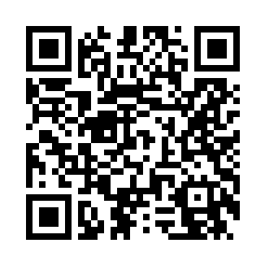
Learning Activity 1
Instruction:
First, write your group number in each technique section, then write your answer.
Apply various NLP techniques to the given text.
"John works at a software company in New York. He enjoys programming and developing new applications for his team."

Slide 9
Reflection- Learning Activity 1
Segmentation: Sentence 1: "John works at a software company in New York.“
Sentence 2: "He enjoys programming and developing new applications for his team.“
Tokenization:
Sentence 1 Tokens: ["John", "works", "at", "a", "software", "company", "in", "New", "York"]
Sentence 2 Tokens: ["He", "enjoys", "programming", "and", "developing", "new", "applications", "for", "his", "team"]
Stop Words Removal:
Sentence 1: After Stop Words Removal: ["John", "works", "software", "company", "New", "York"]
Sentence 2: After Stop Words Removal: ["He", "enjoys", "programming", "developing", "new", "applications", "team"]
Stemming and Lemmatization:
Sentence 1 After Stemming: ["John", "work", "software", "company", "New", "York"]
Sentence 2 After Stemming: ["He", "enjoy", "program", "develop", "new", "applic", "team"]
Sentence 1 After Lemmatization: ["John", "work", "software", "company", "New", "York"]
Sentence 2 After Lemmatization: ["He", "enjoy", "program", "develop", "new", "application", "team"

Slide 10
Reflection- Learning Activity 1
POS Tagging (Part-of-Speech Tagging):
Sentence 1:"John" (Noun, Proper) "works" (Verb, 3rd person singular) "at" (Preposition) "a" (Determiner) "software" (Noun, Common) "company" (Noun, Common) "in" (Preposition) "New" (Adjective) "York" (Noun, Proper)
Sentence 2:"He" (Pronoun) "enjoys" (Verb, 3rd person singular) "programming" (Noun, Gerund) "and" (Conjunction) "developing" (Verb, Gerund) "new" (Adjective) "applications" (Noun, Plural) "for" (Preposition) "his" (Possessive Pronoun) "team" (Noun, Common)
NER Tagging (Named Entity Recognition):
Sentence 1:"John" (Person) "New York" (Location)
Sentence 2:No specific named entities found.

Slide 11
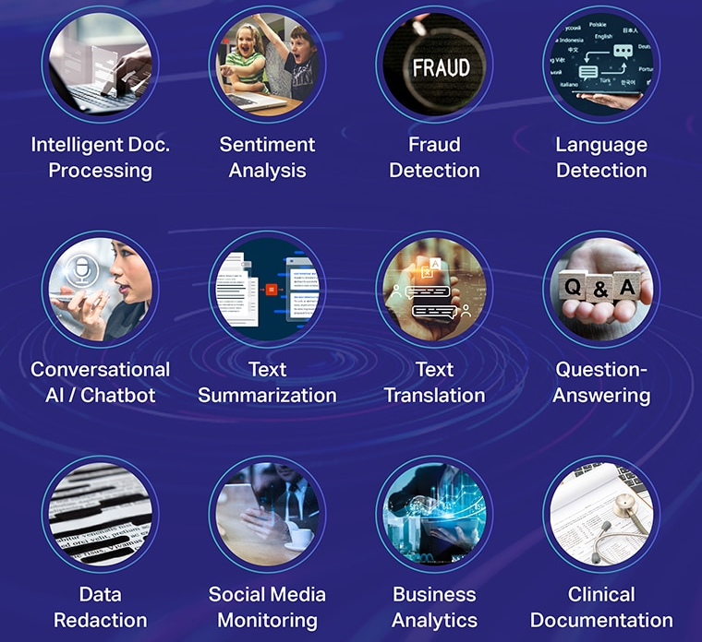
Application of NLP

Slide 12
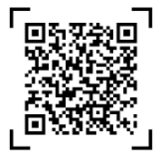
Learning Activity 2
Scan the QR code the answer the given questions
Question 1: Which of the following is an application of NLP that helps in understanding the emotions or sentiments expressed in text?
Question 2: Which NLP application is used for automating conversations with users through chat or voice interfaces?
Question 3: Which of the following NLP applications is designed to detect and prevent fraudulent activities based on text data?
Question 4: What NLP application is used for converting large pieces of text into a condensed version while retaining the key points?
Question 5: Which NLP application is used to detect the language of a given text or speech?

Slide 13
Reflection- Learning Activity 2
Question 1: Which of the following is an application of NLP that helps in understanding the emotions or sentiments expressed in text?
Answer: Sentiment Analysis
Question 2: Which NLP application is used for automating conversations with users through chat or voice interfaces?
Answer: Conversational AI / Chatbot
Question 3: Which of the following NLP applications is designed to detect and prevent fraudulent activities based on text data?
Answer: Fraud Detection
Question 4: What NLP application is used for converting large pieces of text into a condensed version while retaining the key points?
Answer: Text Summarization
Question 5: Which NLP application is used to detect the language of a given text or speech?
Answer: Language Detection

Slide 14
Summary
NLP Techniques and Methods
Segmentation: Break the paragraph into individual sentences.
Tokenization: involves breaking down text into smaller, manageable units called tokens, which can be words, subwords, or even individual characters.
Stop Words Removal: Remove common words (e.g., "the", "a", "is") that do not provide significant meaning.
Stemming and Lemmatization: Apply both stemming and lemmatization to the words to reduce them to their root or base form.
POS Tagging (Part-of-Speech Tagging): Label each word with its corresponding part of speech, such as noun, verb, adjective, etc.
NER Tagging (Named Entity Recognition): Identify and classify named entities (like people, places, organizations) in the text.
Application of NLP
Healthcare
Finance
Customer Service
E-Commerce
Legal

Slide 15
Ensure attainment of LOs in alignment to the learning activities: outcomes (1-2)
Outcome 1: Implementation of core techniques of NLP (Zigsaw activity)
Outcome 2: Identify and evaluate key applications of NLP (MCQ Quiz).

Slide 16

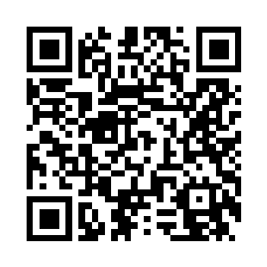
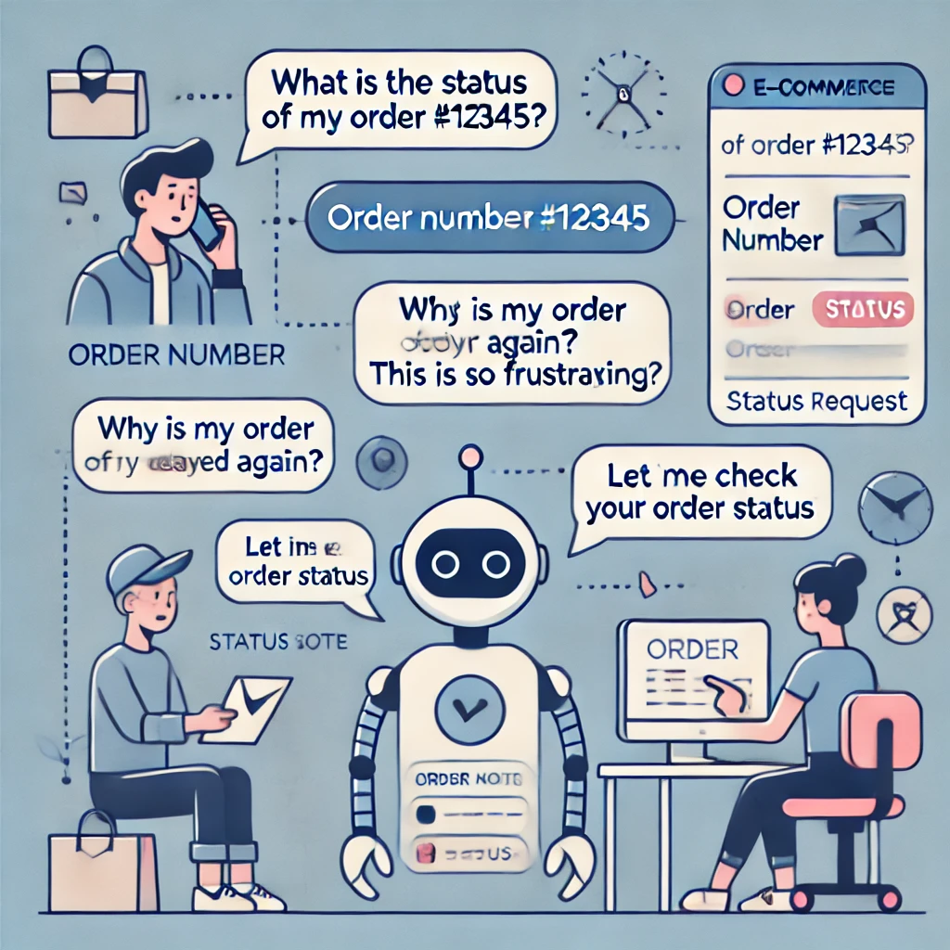
Scenario: Imagine you work for a large e-commerce company that receives hundreds of customer messages each day. Customers ask about their orders and product availability or sometimes share their frustration with delays or problems. Your company has set up a chatbot that handles these customer messages without needing a human to respond every time.
Question 1: How do you think the chatbot is able to understand and respond accurately to different types of customer messages?
Question 2: What do you think about how the chatbot gives the correct information and tone in its responses?

Slide 17
Information to next topic of the course
NLP applications in everyday life
Challenges and Benefits of NLP
The Future of NLP

Slide 18

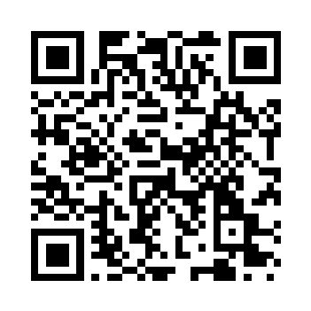
Review and Reflection from students

